Slide 1
Python in Data Science: Pandas

Slide 2

Pandas
A fast, powerful, flexible and easy to use open source data analysis and manipulation tool, built on top of the Python programming language.
Data I/O
Read/write from CSV, Excel, SQL, HTML.
Statistical Analysis
Calculate correlations, avg, max, and min.
Data Manipulation
Grouping, filtering, and pivot tables.
Integration
Merge, join, and concatenate datasets.
Advanced Filtering
Powerful selection using regular expressions.
Open Source
Built on top of Python for widespread compatibility.
Comprehensive Data Analysis with Python

Slide 3
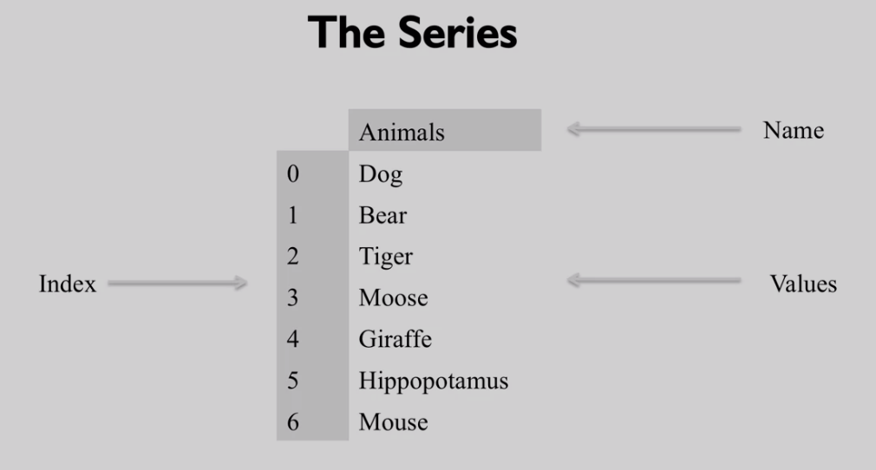
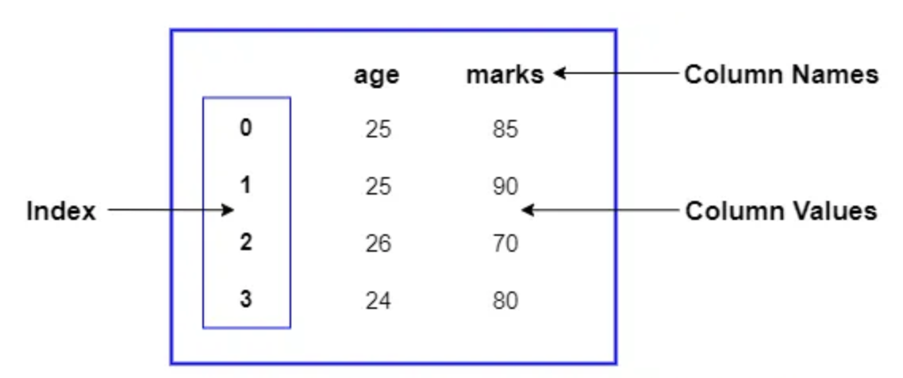
Pandas primary data structures
Series
DataFrame
A Series is very similar to a NumPy array
Collection of Series objects combined to share the same index, forming a 2-dimensional table (rows × columns), where all columns share a common row index.

Slide 4
Pandas Series
A Series is very similar to a NumPy array, yet it can be indexed by a label, instead of just a number location

Slide 5
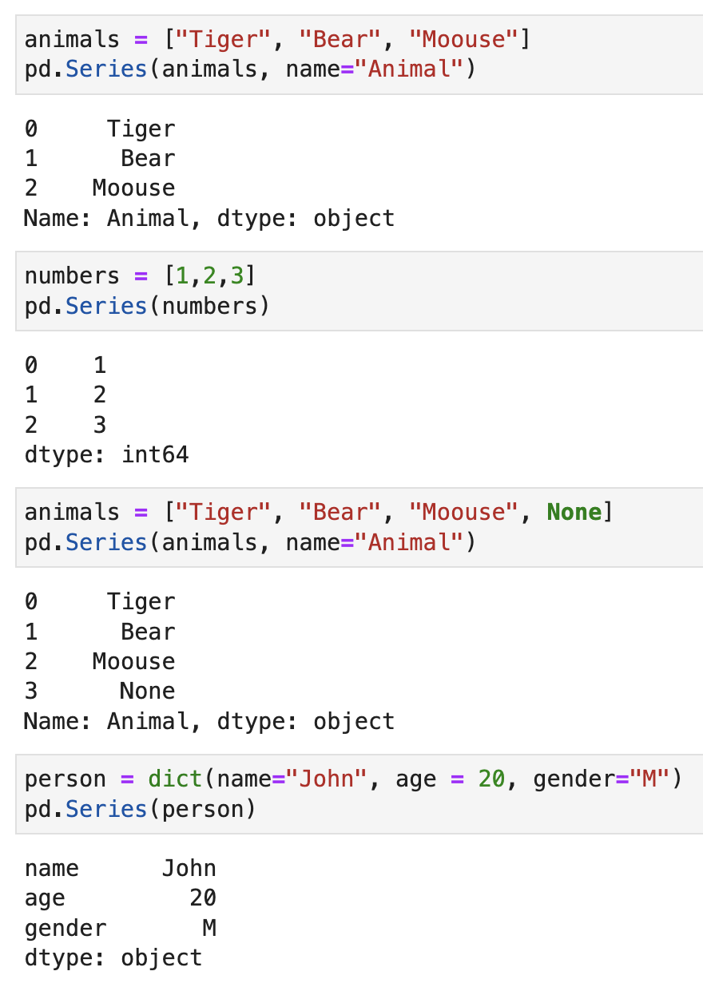
Pandas.Series Creation

Slide 6
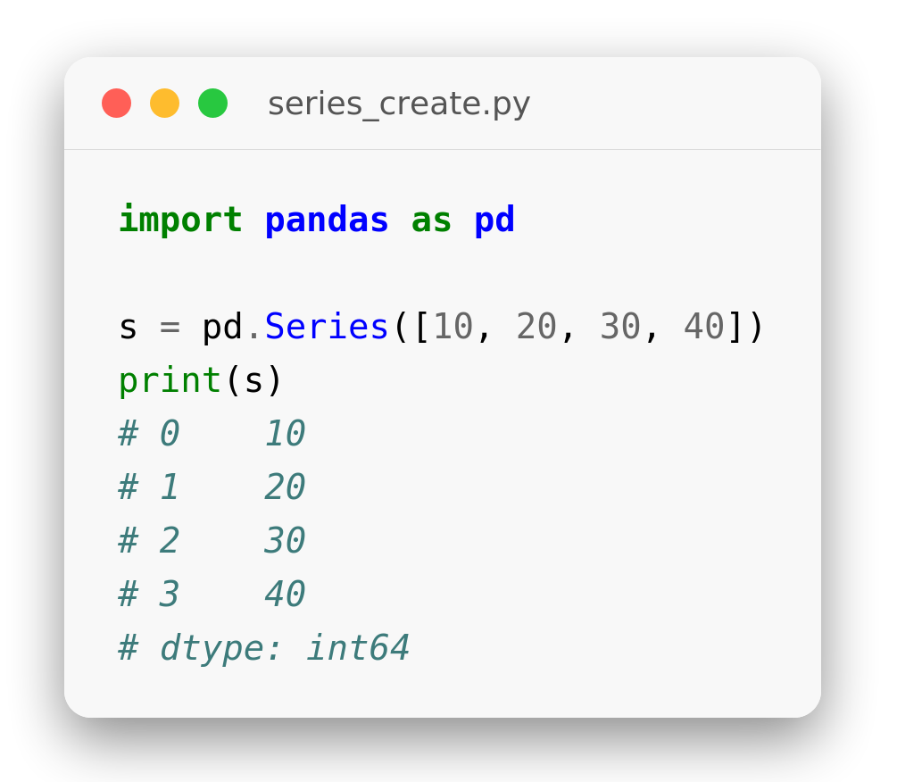
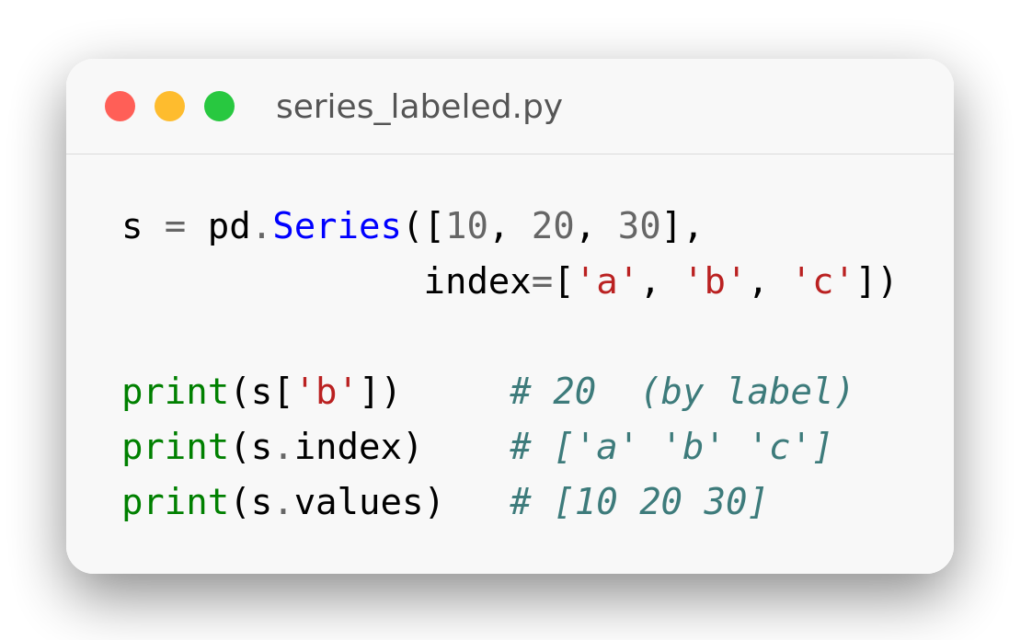
Create a Series with Indexes
From a list
pd.Series([...]) builds a labeled 1-D array.
A default integer Index (0, 1, 2…) is added.
.values holds the data; .index the labels.
Pass index=[...] for custom labels.
Notes:
import pandas as pd
s = pd.Series([10, 20, 30, 40])
print(s)
# 0 10
# 1 20
# 2 30
# 3 40
# dtype: int64
s = pd.Series([10, 20, 30],
index=['a', 'b', 'c'])
print(s['b']) # 20 (by label)
print(s.index) # ['a' 'b' 'c']
print(s.values) # [10 20 30]

Slide 7
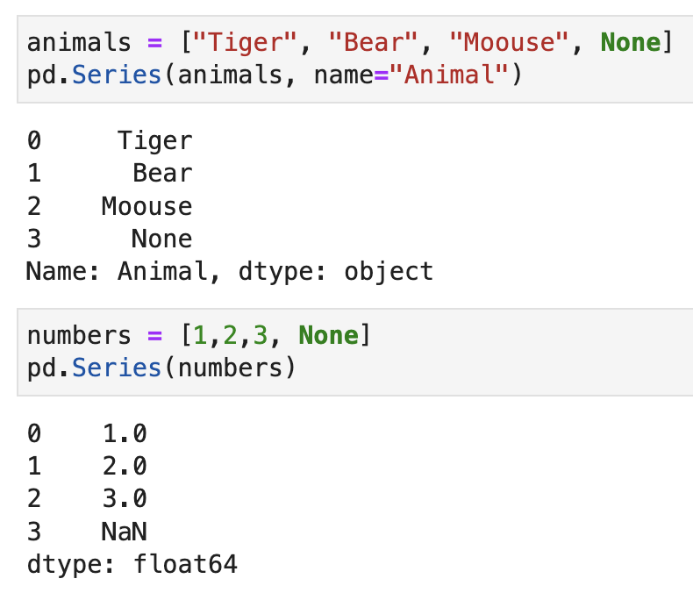
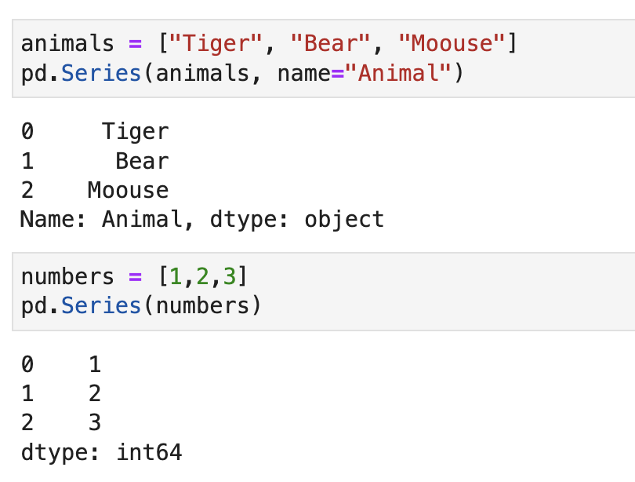
Automatic typed
Notes:
country = {"sg": "singapore","kh": "Cambodia","us": "United States"}
s = pd.Series(country)
s

Slide 8
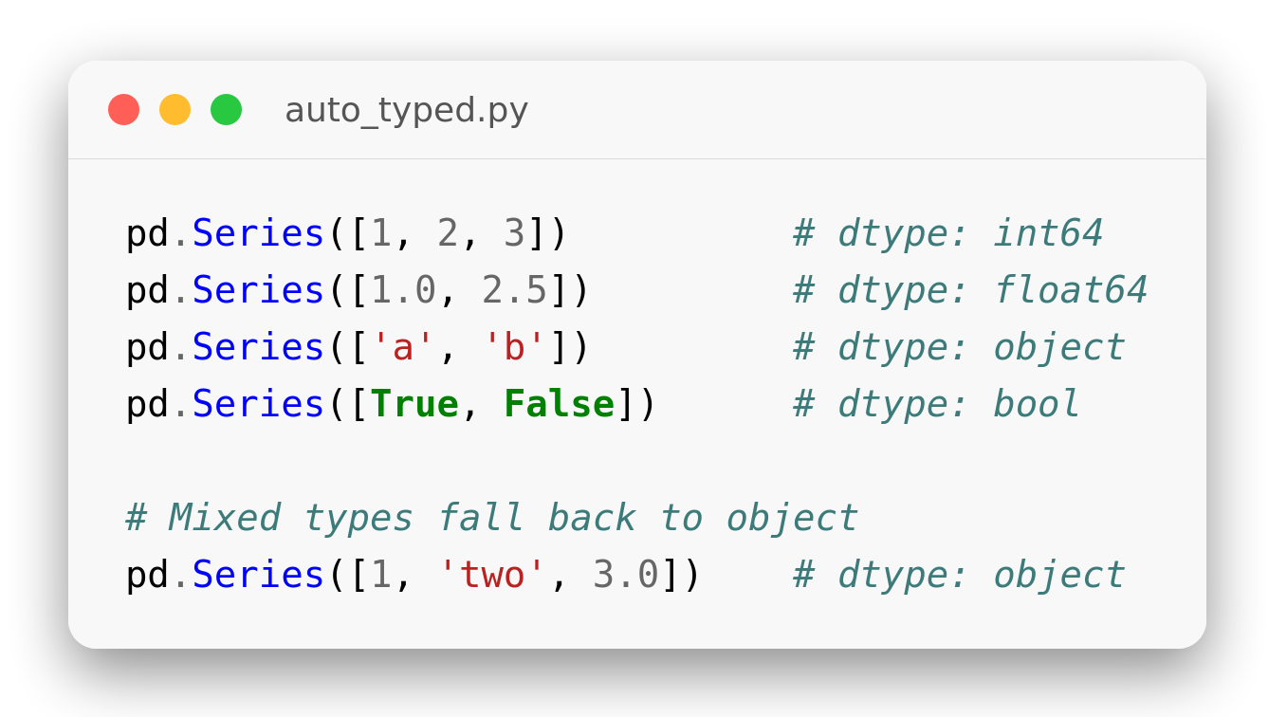
Automatic Typing
Pandas infers dtype
Integers → int64, decimals → float64.
Text → object; True/False → bool.
Mixed types fall back to object.
Check it any time with .dtype.
Notes:
pd.Series([1, 2, 3]) # dtype: int64
pd.Series([1.0, 2.5]) # dtype: float64
pd.Series(['a', 'b']) # dtype: object
pd.Series([True, False]) # dtype: bool
# Mixed types fall back to object
pd.Series([1, 'two', 3.0]) # dtype: object

Slide 9
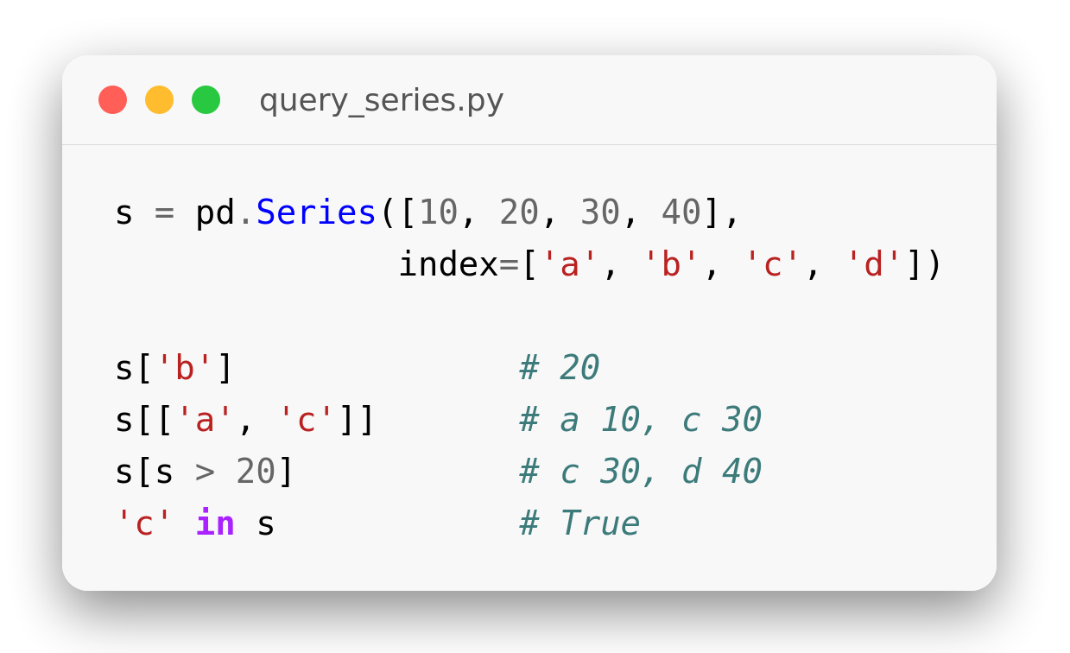
Query a Series
Search and select
s['label'] returns one value by its index label.
Pass a list of labels to select several.
A boolean condition filters like NumPy.
'label' in s tests membership.
Notes:
s = pd.Series([10, 20, 30, 40],
index=['a', 'b', 'c', 'd'])
s['b'] # 20
s[['a', 'c']] # a 10, c 30
s[s > 20] # c 30, d 40
'c' in s # True

Slide 10
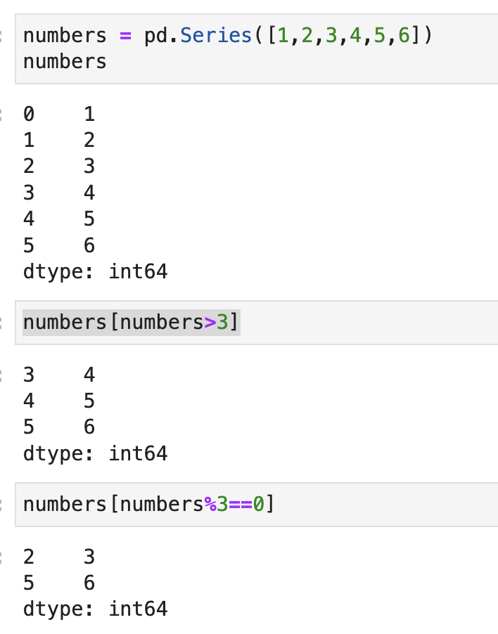
Query / Search a Series

Slide 11
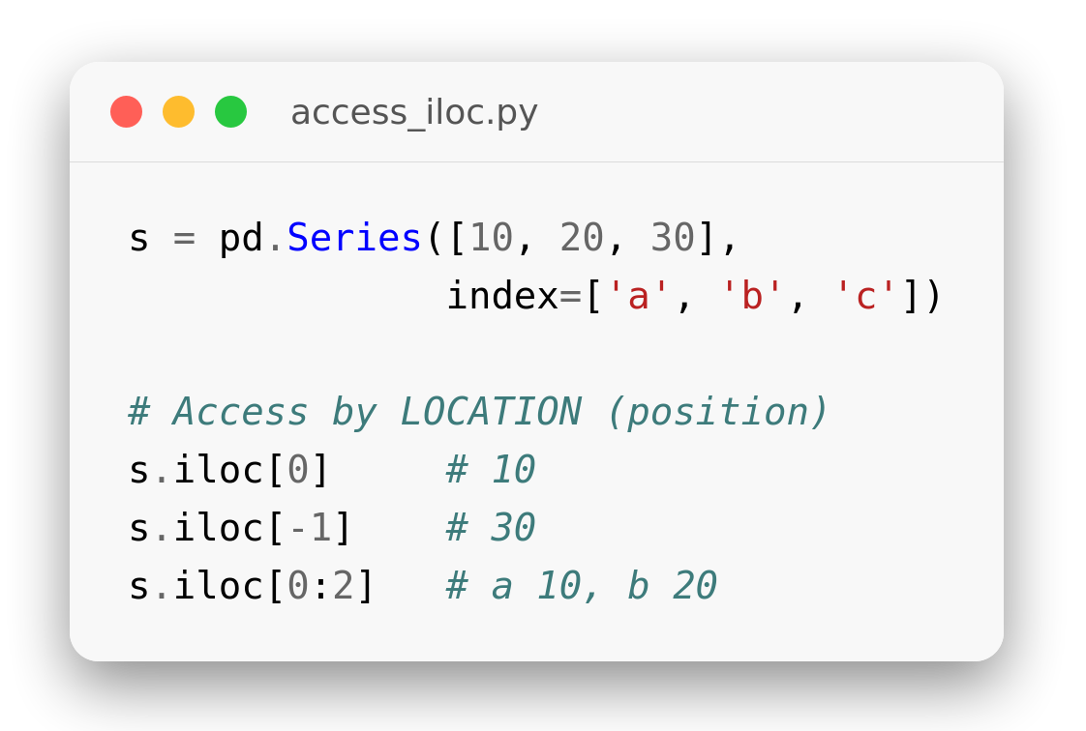
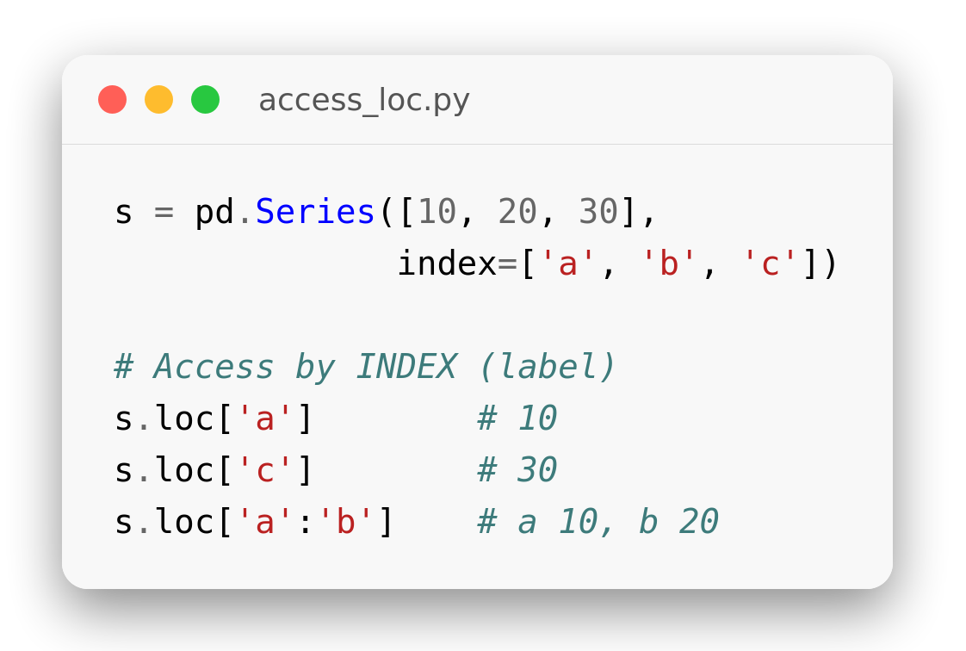
loc vs iloc
Label vs position
.iloc[] accesses by position (0-based).
.loc[] accesses by index label.
Both support slicing and lists.
.loc slices are inclusive of the end label.
Notes:
s = pd.Series([10, 20, 30],
index=['a', 'b', 'c'])
# Access by LOCATION (position)
s.iloc[0] # 10
s.iloc[-1] # 30
s.iloc[0:2] # a 10, b 20
s = pd.Series([10, 20, 30],
index=['a', 'b', 'c'])
# Access by INDEX (label)
s.loc['a'] # 10
s.loc['c'] # 30
s.loc['a':'b'] # a 10, b 20

Slide 12
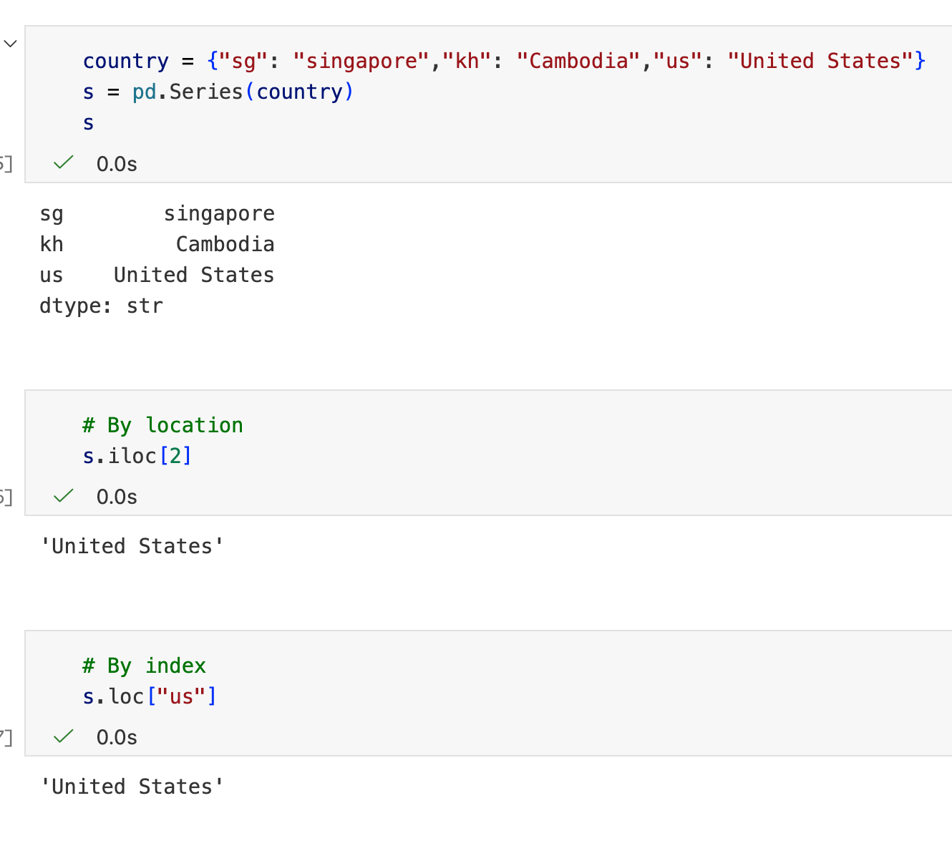
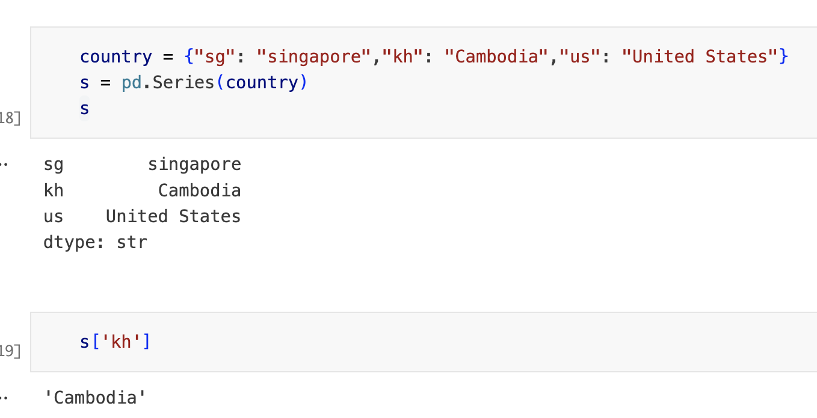
Access by location
Access by index

Slide 13
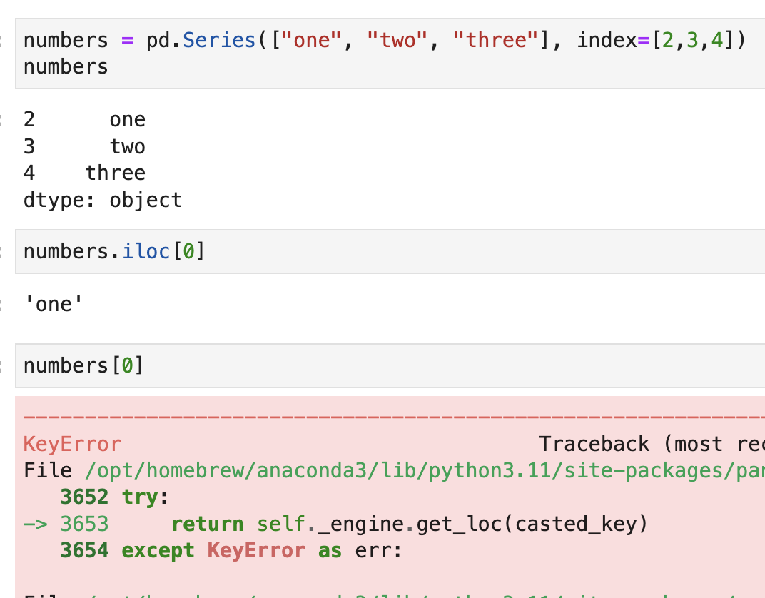
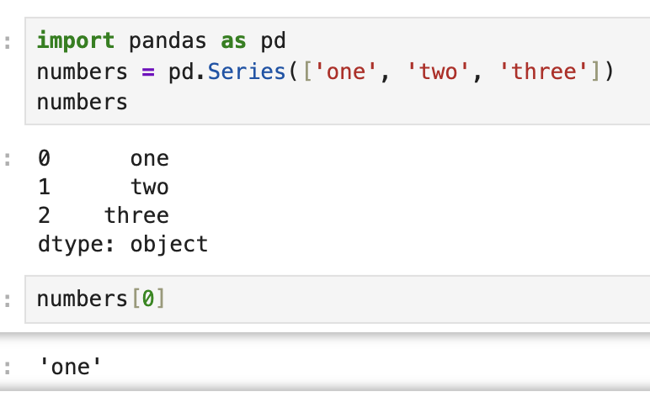
Caution with numerics index
Pandas has numerical index

Slide 14
Aggregation

Slide 15
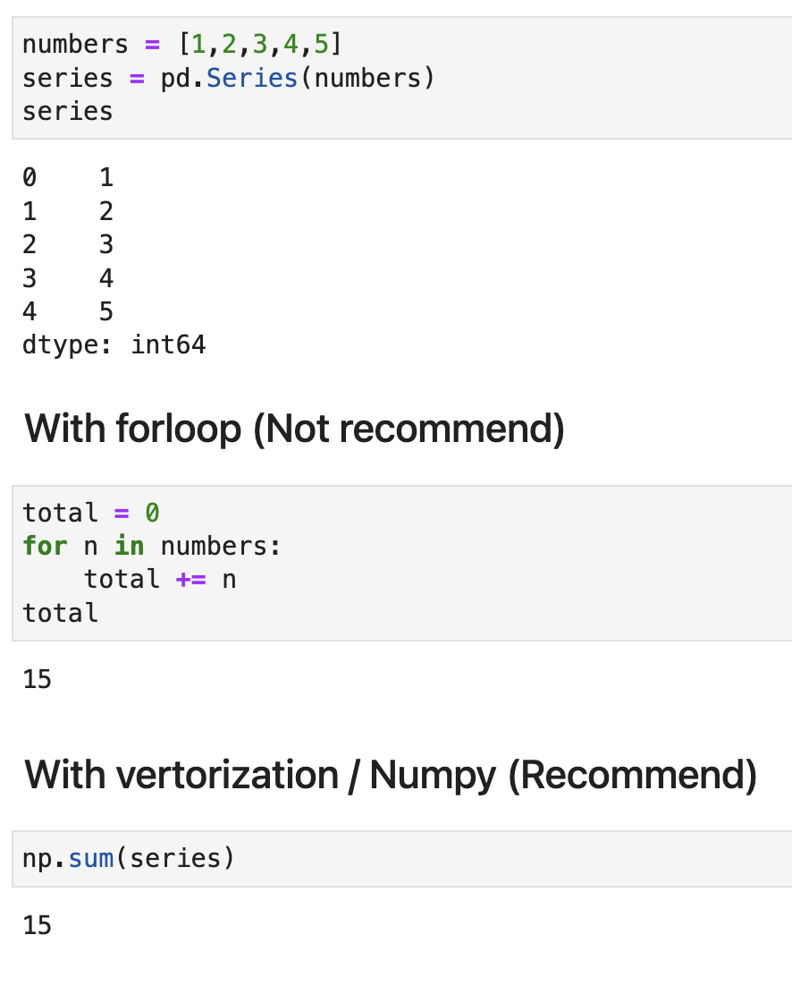
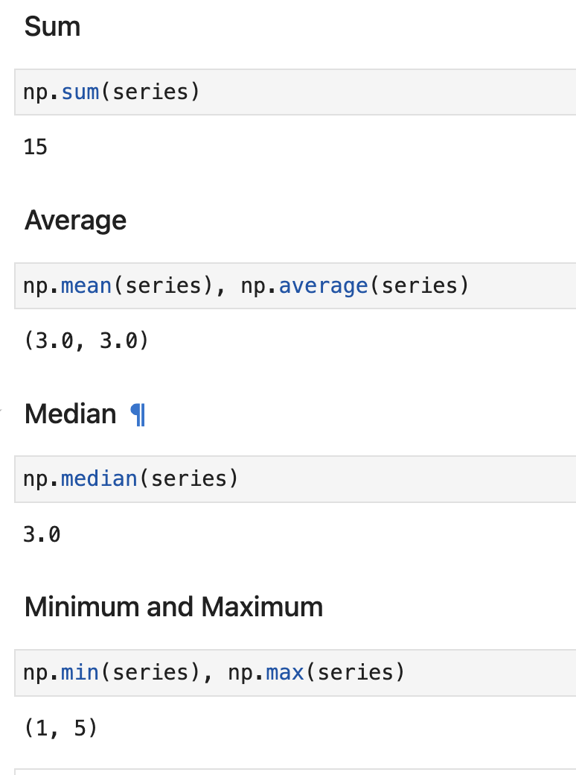
2 Ways of aggregation
Sum / Count / Average / Minimum / Maximum

Slide 16
Pandas.Series vs List

Slide 17
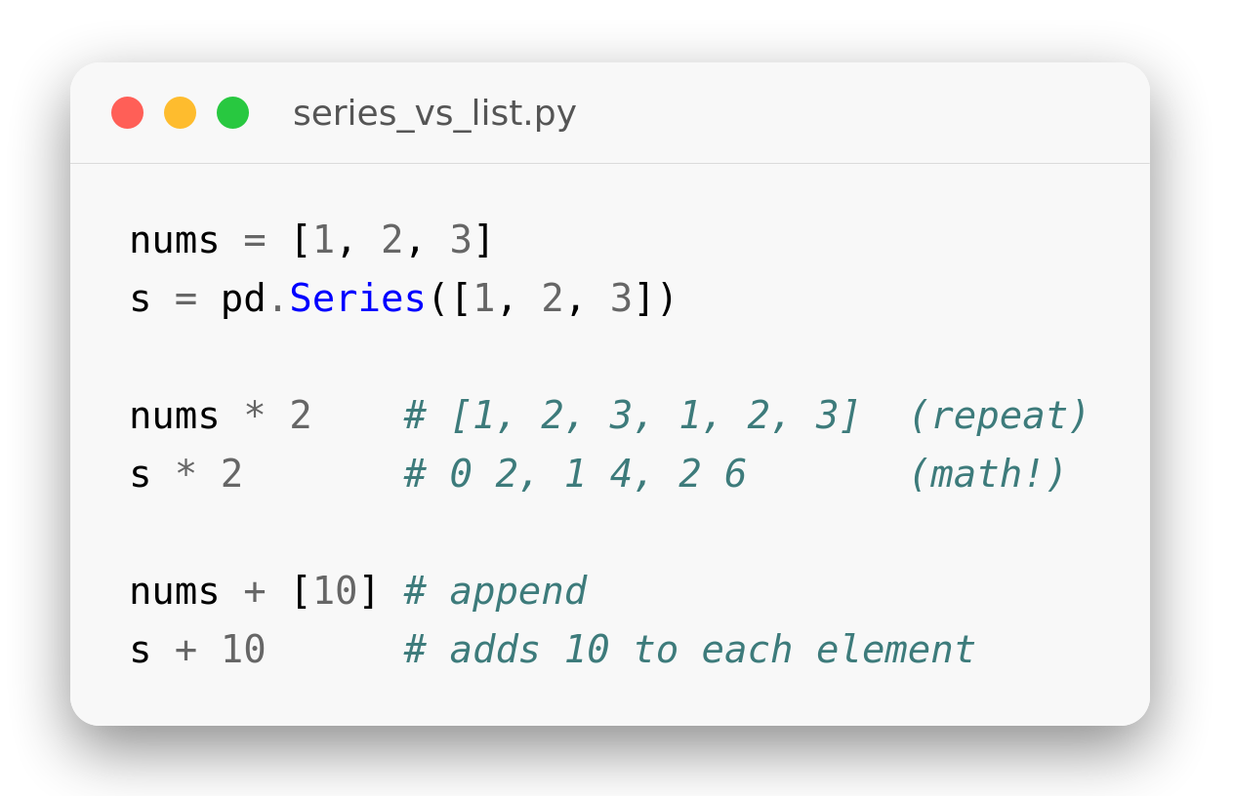
Series vs List
Why not just a list?
list * 2 repeats the list; Series * 2 does math.
Arithmetic on a Series is element-wise.
Series carry an index for alignment.
Series plug straight into the rest of Pandas.
Notes:
nums = [1, 2, 3]
s = pd.Series([1, 2, 3])
nums * 2 # [1, 2, 3, 1, 2, 3] (repeat)
s * 2 # 0 2, 1 4, 2 6 (math!)
nums + [10] # append
s + 10 # adds 10 to each element

Slide 18
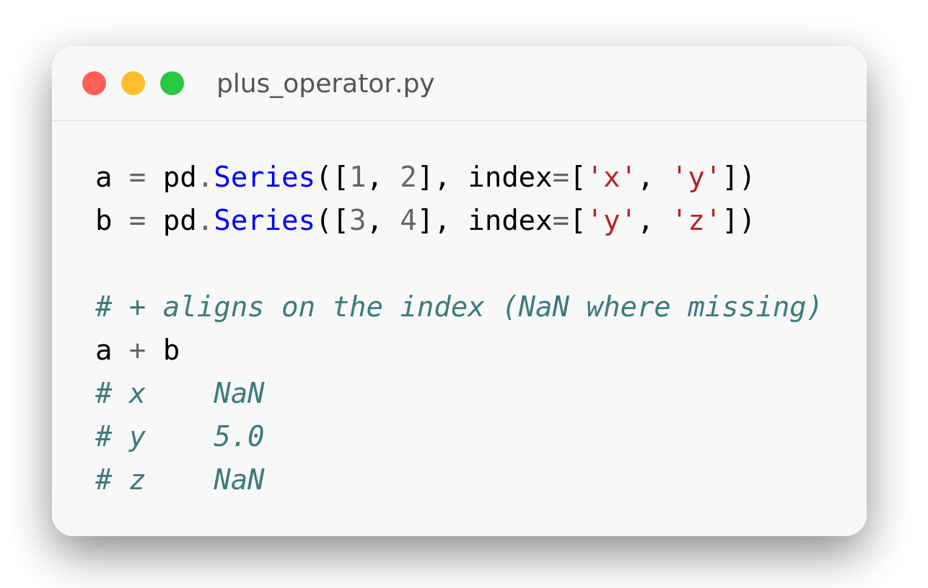
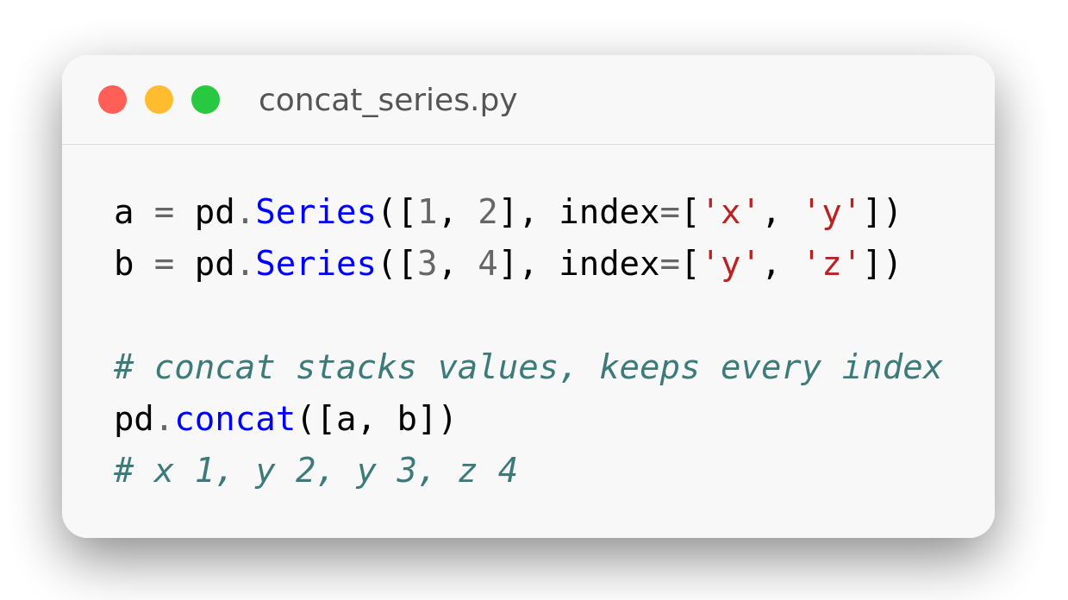
Add vs Concat
Aligning two Series
+ aligns on the index — unmatched labels become NaN.
pd.concat([a, b]) stacks values and keeps all labels.
Use + for math, concat to combine.
Mind the index — it drives both.
Notes:
a = pd.Series([1, 2], index=['x', 'y'])
b = pd.Series([3, 4], index=['y', 'z'])
# + aligns on the index (NaN where missing)
a + b
# x NaN
# y 5.0
# z NaN
a = pd.Series([1, 2], index=['x', 'y'])
b = pd.Series([3, 4], index=['y', 'z'])
# concat stacks values, keeps every index
pd.concat([a, b])
# x 1, y 2, y 3, z 4

Slide 19
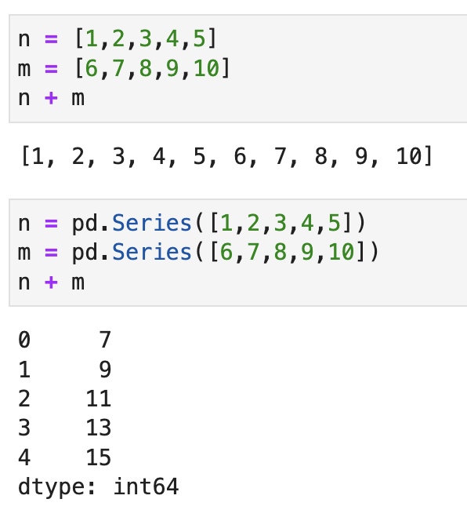
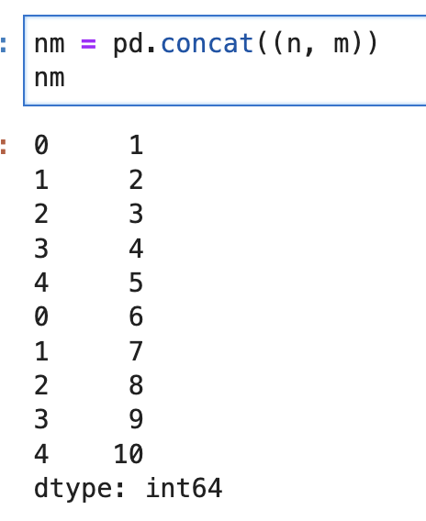
Plus operator
Use Concat for Pandas

Slide 20
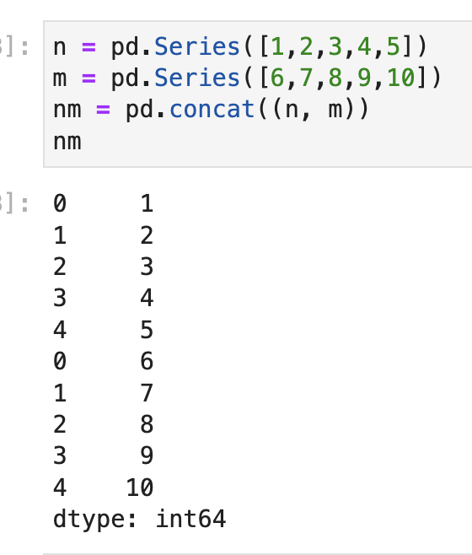
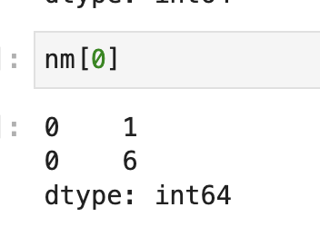
Pandas can be duplicated indexes
Access by index can be multiple value

Slide 21
Pandas Series
Practice Exercises
PYTHON IN DATA SCIENCE · PANDAS
Fill-in-the-blank drills on Series creation, typing, selection, loc/iloc, aggregation, and alignment.
Slash Foundry Co Ltd · August 2026

Slide 22
Creating a Series
SECTION 1 OF 8 · SERIES CREATION
Building a Series from a list, and reading back its values and labels.

Slide 23
Building a Series
1
Create a Series
2
Custom Labels
Create a Series from
[10, 20, 30] (default index)
Create the same values, but
label them ['a', 'b', 'c']
import pandas as pd
s = pd.___([10, 20, 30])
print(s)
# hint: the Pandas class that
# builds a labeled 1D array
s = pd.Series([10, 20, 30], ___=['a', 'b', 'c'])
print(s)
# hint: the keyword argument
# that sets custom labels
Expected output:
Expected output:
[1] → 0 10
1 20
2 30
dtype: int64
[1] → a 10
b 20
c 30
dtype: int64
Notes:
# Exercise 1 — Create a Series
import pandas as pd
s = pd.Series([10, 20, 30])
print(s)
# Exercise 2 — Custom Labels
s = pd.Series([10, 20, 30], index=['a', 'b', 'c'])
print(s)

Slide 24
Series Attributes
3
Just the Values
4
Just the Labels
Get only the underlying
values of s (no labels)
Get only the labels
(not the data) of s
s = pd.Series([10, 20, 30], index=['a', 'b', 'c'])
print(s.___)
# hint: returns a plain NumPy
# array of the data only
s = pd.Series([10, 20, 30], index=['a', 'b', 'c'])
print(s.___)
# hint: the attribute that
# holds the row labels
Expected output:
Expected output:
[1] → [10 20 30]
[1] → Index(['a', 'b', 'c'], dtype='str')
Notes:
# Exercise 3 — Just the Values
s = pd.Series([10, 20, 30], index=['a', 'b', 'c'])
print(s.values)
# Exercise 4 — Just the Labels
s = pd.Series([10, 20, 30], index=['a', 'b', 'c'])
print(s.index)

Slide 25
Query a Series
SECTION 3 OF 8 · SELECTING DATA
Selecting by a single label, multiple labels, a condition, or testing membership.

Slide 26
Selecting by Label
1
Access by Label
2
Multiple Labels
From s (labels a,b,c),
get the value labeled 'b'
Select the values labeled
'a' and 'c' together
s = pd.Series([10, 20, 30], index=['a', 'b', 'c'])
print(s[___])
# hint: index with the label
# as a string
s = pd.Series([10, 20, 30], index=['a', 'b', 'c'])
print(s[___])
# hint: pass several labels
# at once, as a list
Expected output:
Expected output:
[1] → 20
[1] → a 10
c 30
dtype: int64
Notes:
# Exercise 1 — Access by Label
s = pd.Series([10, 20, 30], index=['a', 'b', 'c'])
print(s['b'])
# Exercise 2 — Multiple Labels
s = pd.Series([10, 20, 30], index=['a', 'b', 'c'])
print(s[['a', 'c']])

Slide 27
Filtering & Membership
3
Boolean Filter
4
Membership Test
Select only the values
greater than 15
Check whether the label
'a' exists in s
s = pd.Series([10, 20, 30], index=['a', 'b', 'c'])
print(s[s ___ 15])
# hint: filters just like a
# NumPy boolean mask
s = pd.Series([10, 20, 30], index=['a', 'b', 'c'])
print('a' ___ s)
# hint: the same keyword you'd
# use to test list membership
Expected output:
Expected output:
[1] → b 20
c 30
dtype: int64
[1] → True
Notes:
# Exercise 3 — Boolean Filter
s = pd.Series([10, 20, 30], index=['a', 'b', 'c'])
print(s[s > 15])
# Exercise 4 — Membership Test
s = pd.Series([10, 20, 30], index=['a', 'b', 'c'])
print('a' in s)

Slide 28
loc vs iloc
SECTION 4 OF 8 · POSITION VS LABEL
Two accessors for the same data - by position, and by label.

Slide 29
Position vs Label Access
1
Position Access
2
Label Access
From s (labels a,b,c), get
the 1st element by position
From s, get the element
labeled 'b' directly
s = pd.Series([10, 20, 30], index=['a', 'b', 'c'])
print(s.___[0])
# hint: position-based accessor,
# 0-based like a Python list
s = pd.Series([10, 20, 30], index=['a', 'b', 'c'])
print(s.___['b'])
# hint: the label-based
# accessor, not position
Expected output:
Expected output:
[1] → 10
[1] → 20
Notes:
# Exercise 1 — Position Access
s = pd.Series([10, 20, 30], index=['a', 'b', 'c'])
print(s.iloc[0])
# Exercise 2 — Label Access
s = pd.Series([10, 20, 30], index=['a', 'b', 'c'])
print(s.loc['b'])

Slide 30
Slicing Two Ways
3
Position Slice
4
Label Slice
Slice the first two elements
by position (stop excluded)
Slice from label 'a' through
label 'b' - inclusive of 'b'
s = pd.Series([10, 20, 30], index=['a', 'b', 'c'])
print(s.iloc[___])
# hint: a normal Python slice -
# the stop index is excluded
s = pd.Series([10, 20, 30], index=['a', 'b', 'c'])
print(s.loc[___])
# hint: with .loc, the end
# label IS included
Expected output:
Expected output:
[1] → a 10
b 20
dtype: int64
[1] → a 10
b 20
dtype: int64
Notes:
# Exercise 3 — Position Slice
s = pd.Series([10, 20, 30], index=['a', 'b', 'c'])
print(s.iloc[0:2])
# Exercise 4 — Label Slice
s = pd.Series([10, 20, 30], index=['a', 'b', 'c'])
print(s.loc['a':'b'])

Slide 31
Ambiguous Numeric Index
5
Numeric Index Caution
s2 has a numeric index
[100,101,102] - get position 0 safely
s2 = pd.Series([7, 8, 9], index=[100, 101, 102])
print(s2.___[0])
# hint: with numeric labels, a plain
# s2[0] would be ambiguous
Expected output:
[1] → 7
Notes:
# Exercise 5 — Numeric Index Caution
s2 = pd.Series([7, 8, 9], index=[100, 101, 102])
print(s2.iloc[0])

Slide 32
Aggregation
SECTION 5 OF 8 · SUMMARY STATISTICS
The same aggregate can be called as a Series method or as a NumPy function.

Slide 33
Basic Aggregates
1
Sum
2
Count
Add up every value in s
Count how many values
are in s
s = pd.Series([10, 20, 30, 40])
print(s.___())
# hint: the total of all values
s = pd.Series([10, 20, 30, 40])
print(s.___())
# hint: how many entries
# the Series holds
Expected output:
Expected output:
[1] → 100
[1] → 4

Slide 34
Add vs Concat
SECTION 7 OF 8 · ALIGNING VS STACKING
One aligns on the index and does math; the other just stacks values together.

Slide 35
Combining Two Series
1
Index Alignment
2
Stack & Keep All
Add two Series whose
indexes don't fully match
Combine a and b by stacking
them, keeping every label
a = pd.Series([1, 2, 3], index=['x', 'y', 'z'])
b = pd.Series([10, 20], index=['x', 'w'])
print(a ___ b)
# hint: unmatched labels become
# NaN, not an error
a = pd.Series([1, 2, 3], index=['x', 'y', 'z'])
b = pd.Series([10, 20], index=['x', 'w'])
print(pd.___([a, b]))
# hint: takes a list of Series
# and stacks them together
Expected output:
Expected output:
[1] → w NaN
x 11.0
y NaN
z NaN
dtype: float64
[1] → x 1
y 2
z 3
x 10
w 20
dtype: int64
Notes:
# Exercise 1 — Index Alignment
a = pd.Series([1, 2, 3], index=['x', 'y', 'z'])
b = pd.Series([10, 20], index=['x', 'w'])
print(a + b)
# Exercise 2 — Stack & Keep All
a = pd.Series([1, 2, 3], index=['x', 'y', 'z'])
b = pd.Series([10, 20], index=['x', 'w'])
print(pd.concat([a, b]))

Slide 36
Duplicate Indexes
SECTION 8 OF 8 · NOT ALWAYS UNIQUE
Pandas allows repeated labels - accessing one can return several values.

Slide 37
Duplicate Labels
1
Duplicate Labels
2
Access a Duplicate
Create a Series where the
label 'a' appears twice
Access the values labeled 'a' -
notice you get back more than one
s = pd.___([1, 2, 3], index=['a', 'a', 'b'])
print(s)
# hint: same class used to
# create any Series
print(s[___])
# hint: the same single-label
# access as always
Expected output:
Expected output:
[1] → a 1
a 2
b 3
dtype: int64
[1] → a 1
a 2
dtype: int64
Notes:
# Exercise 1 — Duplicate Labels
s = pd.Series([1, 2, 3], index=['a', 'a', 'b'])
print(s)
# Exercise 2 — Access a Duplicate
print(s['a'])

